Slide 1
Predicting Bird Species
RA2011026010082-Sindhu KALEESWARAN
RA2011026010099-APARNA SURESH
RA2011026010113-CHEREDDY SOWMYA SRI

Slide 2
Table of Contents
Problem Statement
Literature Review
Limitations with citations
Objective
Proposed Methodology
Architecture Diagram
Modules Description
Results
Conclusion
References

Slide 3
Problem Statement
The project aims to quantify the qualitative description of different bird species using machine learning techniques and use it as an effective tool for bird species identification from images. This project attempts to design and adopt the bird species identification system based on image feature analysis.

Slide 4
Literature Review:
Bird species identification has been the subject of extensive research in the field of ornithology.
Image Processing: Bird species can also be identified based on their visual characteristics. Image processing techniques have been used to identify bird species from photographs or videos. This can involve analyzing the shape, color, and markings of the bird to identify the species.
Overall, bird species identification is a complex and challenging task that requires a combination of different approaches. Advances in machine learning and computer vision are likely to continue to improve bird species identification in the future.

Slide 5
Limitations with citations:
One limitation of citing sources for bird species identification using computer vision is the availability and quality of the data. There may be limited or incomplete datasets available, which can limit the effectiveness of machine learning algorithms used for bird species identification. Additionally, images of birds may be taken under different lighting conditions, angles, or distances, which can make it challenging to develop accurate models that can identify bird species under different conditions.
Another limitation is the lack of standardization in the labeling and annotation of bird images. There may be variations in the accuracy of manual labeling, which can lead to errors in the training data used for machine learning algorithms.
They may have limitations in identifying certain bird species, especially those that have similar visual characteristics or have variations within the same species. This can lead to misidentification or low accuracy in species recognition.

Slide 6
Objective:
The objective for bird species identification is to accurately identify various bird species present in a area. This information can be used for various purposes, including conservation, research, and recreation.

Slide 7
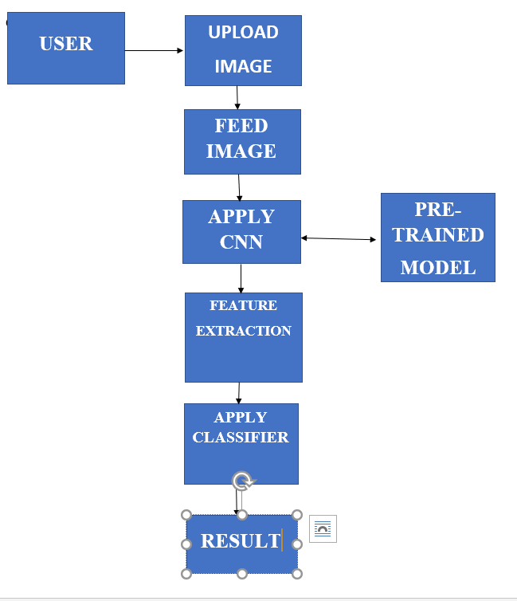
Proposed Methodology :Technical depth

Slide 8
Technique used:CNN
Start with an input image
Apply different filters to it to create a feature map
Apply a ReLU function to increase non-linearity
Apply a pooling layer to each feature map
Flatten the pooled images into one long vector.
Input the vector into a fully connected artificial neural network.
Process the features through the network. The final fully connected layer provides the “voting” of the classes that we’re after.
Train through forward propagation and backpropagation for many, many epochs. Repeat training until a well-defined neural network with trained weights and feature detectors is obtained.

Slide 9
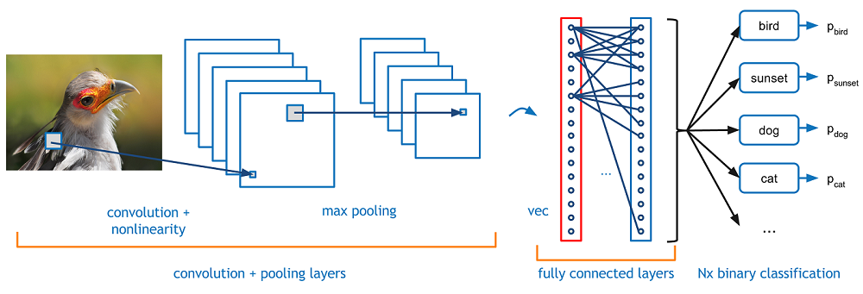
Architecture Diagram:

Slide 10
Modules Description:
Data Collection and Preprocessing: This module involves collecting a large dataset of bird images and preprocessing them to standardize their size, shape, and color. The images may be labeled with their corresponding bird species to create a supervised learning dataset.
Training: In this module, the CNN is trained on the preprocessed dataset of bird images using backpropagation to adjust the weights of the network. The trained CNN can recognize patterns in the images that correspond to different bird species.
Testing and Validation: This module involves evaluating the performance of the trained CNN on a separate test dataset. This is critical to ensure that the CNN can accurately classify bird species in new, unseen images.

Slide 11
Optimization: This module involves fine-tuning the CNN to improve its accuracy. This can include adjusting the architecture of the network, optimizing the learning rate and other hyperparameters, and data augmentation techniques.
Deployment: The final module involves deploying the trained CNN in a real-world application for bird species identification. This can include integrating the CNN into a mobile application or a web-based interface.

Slide 12
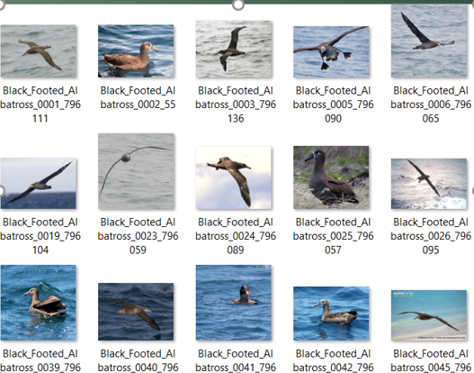
Data Set
The dataset is avaliable at Caltech-UCSD Birds-200-2011 dataset.
Caltech-UCSD Birds 200 (CUB-200) is an image dataset with photos of 200 bird species.
Number of categories: 200
Number of images: 11788

Slide 13
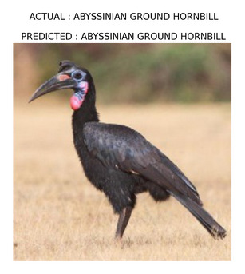
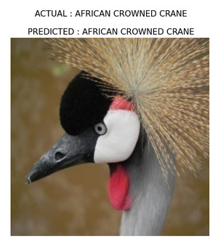
Result:

Slide 14
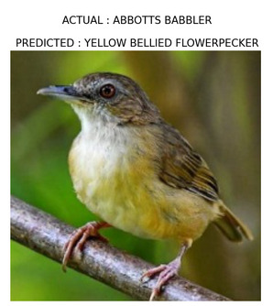
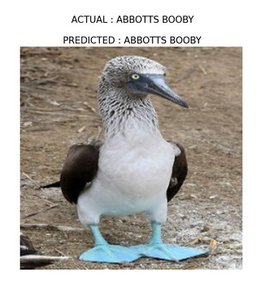

Slide 15
Conclusion:
In summary, bird species prediction is a fascinating and valuable area of research that combines ecological knowledge with advanced machine learning techniques. Continued advancements in technology, data collection, and algorithm development will contribute to more accurate predictions, leading to better understanding and conservation of avian biodiversity.

Slide 16
References:
https://towardsdatascience.com/project-ornithowav-bird-species-identification-using-deep-learning-2457f456fc22
https://www.ijert.org/research/bird-species-identification-using-deep-learning-IJERTV8IS040112.pdf
https://jpinfotech.org/bird-species-identification-using-deep-learning/

Slide 17
THANK YOU

